Slide 1
Employee Data Using Excel STUDENT NAME : MEGAVARSHINI.R REGISTER NO: 312204775 DEPARTMENT :III-B.COM(ACCOUNTING AND FINANCE) COLLEGE: THIRUMURUGAN ARTS AND SCINCE COLLEGE FOR WOMEN`S

Slide 2
EMPLOYEE DATA ANALYSIS USING EXCEL

Slide 3

Agenda
1.Problem statement
2.Project Overview
3.End Users
4.Our Solution and Proposition
5.Data Description
6.Modelling Approach
7.Results and Discussion
8.Conclusion

Slide 4

PROJECT TITLE Employee Performance Analysis Using Excel

Slide 5
PROBLEM STATEMENT
Employee performance analysis using excel involves evaluating and measuring an employee work effectiveness and efficiency based on key performance indicators (KPI) .
This data is them analysis using excel condition formatting ,to identify patterns ,strengths, and areas for improvement.

Slide 6

EMPLOYEE PROJECT OVERVIEW
A project summary is a document or part of a larger document that`s comprehensive but concise in providing an overview of the proposed project ,including key details.
It also outline the project`s objectives , background information to place it in context ,requirement ,problems , analysis and ends with a conclusion.

Slide 7
WHO ARE THE END USERS IN EMPLOYEE
In the context of a company . Employees are the end users of products and services that the company purchases for them to use.
They are hands –on customers who work directly with product and tools to achieve their organization`s business goals.

Slide 8
OUR SOLUTION AND ITS VALUE PROPOSTION
*Data –Drive Insights : Enables managers to make information decision based on accurate ,real –time performance data.
*Improved Efficiency : Automates the data collection and analysis process , saving time and reducing manual errors.
*Enhanced Employee Development : Identifies training needs and development opportunities , leading to a more skilled workforce.
*Better Performance Management : Helps in recognizing top performance and addressing under performance , ultimately improved overall productivity .
*Cost –Effective Solution : Leverages the widely accessible excel platform , avoiding the needs for expensive software or tools.

Slide 9
DATASET DESCRIPTION
Employee ID: unique identifier for each employee in the organization
2. First Name : The first name of the employee.
3.Last Name : The last name of the employee.
4.Email: The email address associated with the employee`s communication within the organization
5.Business unit: The specific business unit or department to which the employee belongs.
6.State: The state or region where the employee is located.
7.Jobs Function : A brief description of the employee`s primary job function or role.
8.Gender : A code representing the gender of the employee`s (e.g. M For male ,F for female ,N for non-binary).
9.Performance Score : A score indicating the employee`s performance level.
10.Current Employee Rating : The current rating or evaluating of the employee`s overall performance.

Slide 10

THE “WOW” IN OUR SOLUTION
*PREDICITIVE ANALYSIS : Integrating predictive models to forecast future performance trends based on historical data .
*AUTOMATED ALERTS: The tools can be set up to send automated alerts for critical performance issues, ensuring that managers are immediately notified .

Slide 11
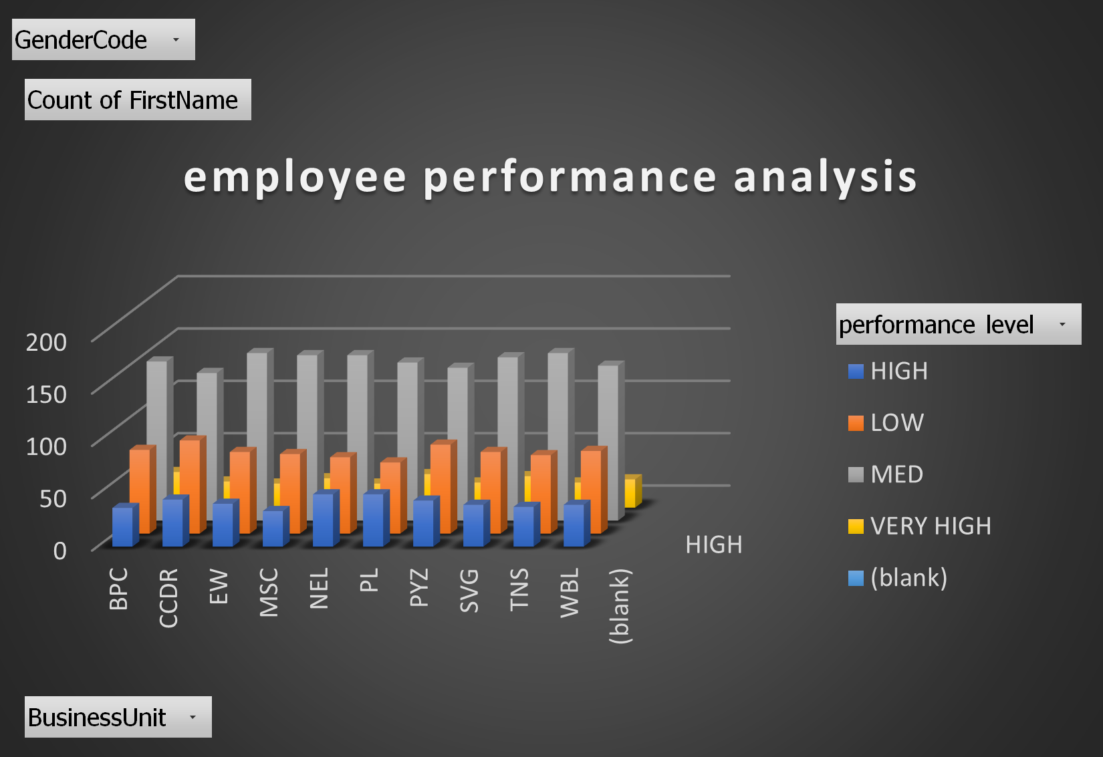
MODELING

Slide 12
RESULTS
DATA ANALYSIS IS THE MOST CRUCIAL PART OF THE ANY RESEARCH .DATA ANALYSIS SUMMARIZES COLLECTED DATA .
IT INVOLVES THE INTERPRETATION OF DATA GATHERED THROUGH THE USE OF ANALYTICAL AND LOGICAL REASONING TO DETERMINE PATTERNS,RELATIONSHIPS OR TRENDS.

Slide 13
CONCLUSION
THE “EMPLOYEE PERFORMANCE ANALYSIS SOLUTION FOR EVALUATING AND MANAGING ENMPLOYEE PERFORMANCE.
BY LEVERAGE EXCEL`S POWERFUL TOOLS----SUCH AS FILTERING ,PIVOT TABLES ,CHART AND CONDITIONAL FORMATTING THE PROJECT TRANSFORMS RAW PERFORMANCE DATA INTO ACTIONABLE INSIGHTS.

